Slide 1
Decision Making, Branching
nested if-else, if-else ladder

Slide 2
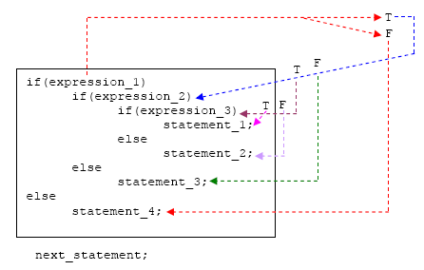
Nested if-else Statement

Slide 3
If-else nesting -Explanation
1. The if-else constructs can be nested (placed one within another) to any depth.
2. In this nested form, expression_1 is evaluated.
If it is zero (FALSE-F), statement_4 is executed and the entire nested if statement is terminated;
If not (TRUE-T), control goes to the second if (within the first if) and expression_2 is evaluated. If it is zero, statement_3 is executed;
If not, control goes to the third if (within the second if) and expression_3 is evaluated.
If it is zero, statement_2 is executed;
If not, statement_1 is executed. The statement_1 (inner most) will only be executed if all the if statement is true.

Slide 4
Smallest among three numbers
#include <stdio.h>
int main()
{
int a, b, c, smallest;
printf(“Enter a, b & c\n“);
scanf(“%d %d %d, &a,&b,&c);
if (a < b)
{ if (a < c)
{ smallest = a; }
else
{ smallest = c; } }
else
{ if (b < c)
{ smallest = b; }
else
{ smallest = c; }
}
printf(“Smallest is %d“,smallest);
return 0;
}

Slide 5
Nested if statements
if (number > 5)
if (number < 10)
printf(“1111\n“);
else printf(“2222\n“);
Rule: an else goes with the most recent if, unless braces indicate otherwise
if (number > 5) {
if (number < 10)
printf(“1111\n“);
}
else printf(“2222\n“);

Slide 6
The else-if ladder
if (Expression_1 )
{
statement _block1
}
else if (Expression_2)
{
statement _block2
}
…….
else if (Expression_n)
{
statement _blockn
}
else
{
last_statement
}
Next_statement

Slide 7
else if ladder -Explanation
expression_1 is first evaluated. If it is TRUE, statement_1 is executed and the whole statement terminated and the next_statement is executed.
On the other hand, if expression_1 is FALSE, control passes to the else if part and expression_2 is evaluated.
If it is TRUE, statement_2 is executed and the whole system is terminated.
If it is False, other else if parts (if any) are tested in a similar way.
Finally, if expression_n is True, statement_n is executed; if not, last_statement is executed.
Note that only one of the statements will be executed others will be skipped.
The statement_n’s could also be a block of statement and must be put in curly braces.

Slide 8
else-if ladder Flow of control
True
Condition-1
False
True
Condition-2
False
statement-1
True
False
statement-2
Condition-3
statement-3
True
False
Condition-n
statement-n
default statement
next statement

Slide 9
Testing for character ranges
#include<stdio.h>
int main()
{
char ch;
printf(“enter a character\n”);
scanf(“%c”,&ch);
if (ch >= 'a' && ch <= 'z')
printf(“lowercase char\n“);
else if (ch >= ‘A' && ch <= ‘Z')
printf(“uppercase char\n“);
else if (ch >= ‘0' && ch <= ‘9')
printf(“digit char\n“);
else
printf(“ special char\n”);
return 0;
}

Slide 10
WAP using else-if ladder to calculate grade for the marks entered
int main() {
char cgrade;
int imarks;
printf("enter marks“);
scanf(“%d”,&imarks);
if(imarks>79)
cgrade = 'A';
else if (imarks>59)
cgrade = 'B';
else if (imarks>49)
cgrade = 'C';
else if (imarks>39)
cgrade = 'D';
else
cgrade = 'F';
printf(“Grade :%c\n”,cgrade);
return 0;
}
For inputs
imarks= 46
grade = D
imarks= 64
grade = B
if(imarks>79)
cgrade = 'A';
else if (imarks>59)
cgrade = 'B';
else if (imarks>49)
cgrade = 'C';
else if (imarks>39)
cgrade = 'D';
else
cgrade = 'F';

Slide 11
Example: else-if
// Program to implement the sign function
#include <stdio.h>
int main ( )
{
int number, sign;
printf("Please type in a number: “);
scanf(“%d”,&number);
if ( number < 0 )
sign = -1;
else if ( number == 0 )
sign = 0;
else // Must be positive
sign = 1;
printf(“Sign = %d“,sign);
return 0;
}

Slide 12
Example – multiple choices
/* Program to evaluate simple expressions of the form number operator number */
#include <stdio.h>
int main ( )
{
float value1, value2,result;
char operator;
printf("Type in your expression.\n“);
scanf(“%f %c %f”, &value1,&operator,&value2);
if ( operator == '+' )
{result=value1+value2;
printf(“%f”,result);}
else if ( operator == '-' )
{result=value1-value2;
printf(“%f”,result);}
else if ( operator == '*' )
{result=value1*value2;
printf(“%f”,result);}
else if ( operator == '/' )
{result=value1/value2;
printf(“%f”,result);}
else
printf("Unknown operator.\n“);
return 0;
}

Slide 13
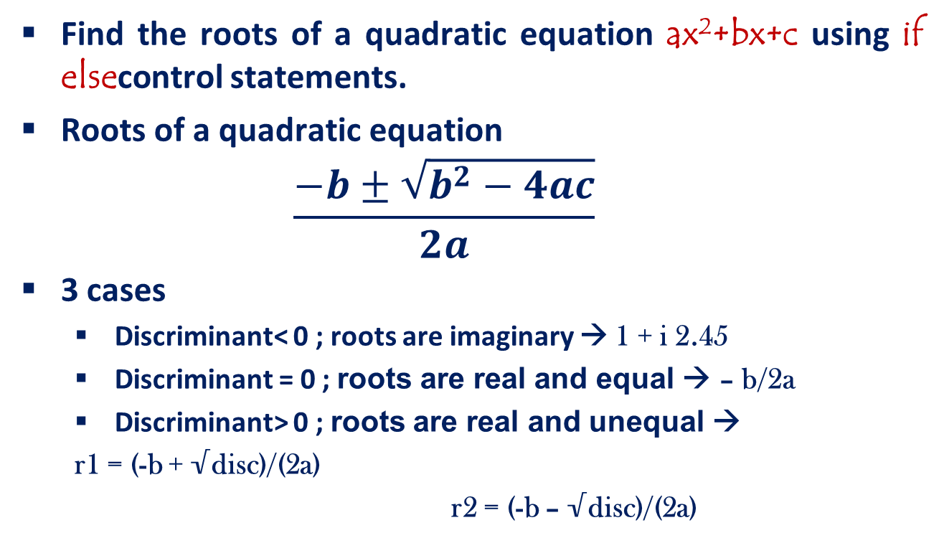
Problem…

Slide 14
Find the roots of Quadratic equation using if-else statement
else if (disc==0)
{
printf(“Real & equal roots“);
re=-b / (2*a);
printf(“Root1 and root2 are %.21f”,re);
}
else /*disc > 0 */
{
printf(“Real & distinct roots“);
printf(“Roots are“);
root1=(-b + sqrt(disc))/(2*a);
root2=(-b - sqrt(disc))/(2*a);
printf(“Root1 = %.21f and root2 =%.21f”,root1,root2);
}
return 0;
}
#include<stdio.h>
#include<math.h>
int main()
{
float a,b,c,root1,root2,re,im, disc;
scanf(“%f %f %f”,&a,&b,&c);
disc=b*b-4*a*c;
if (disc<0)
{
printf("imaginary roots\n“);
re= - b / (2*a);
im = pow(fabs(disc),0.5)/(2*a);
printf(“root1=%.21f+%.21fi and root2 =%.21f-%.2fi”, re,im,re,im);
}

